Slide 1
Week One

Slide 2
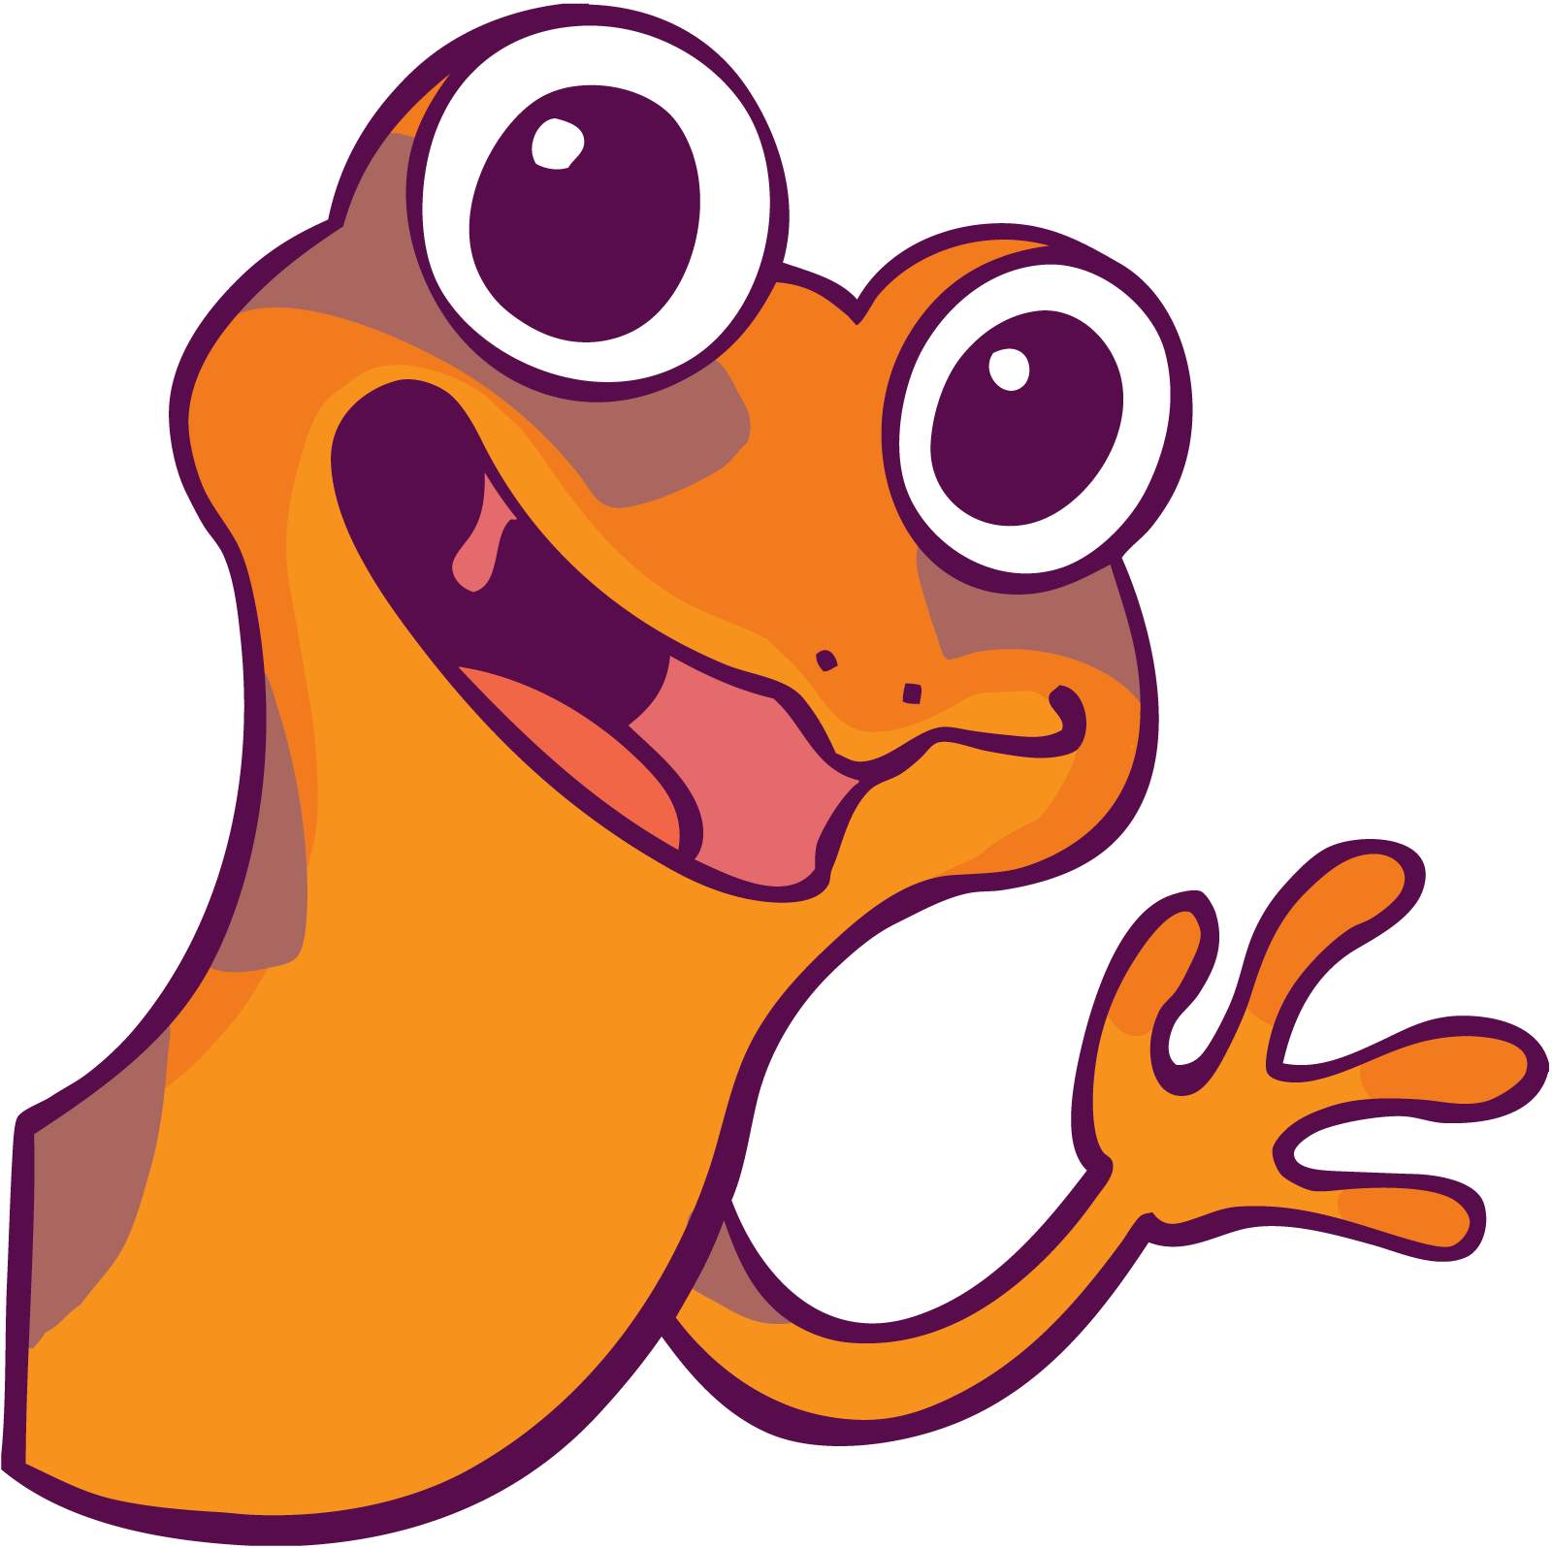
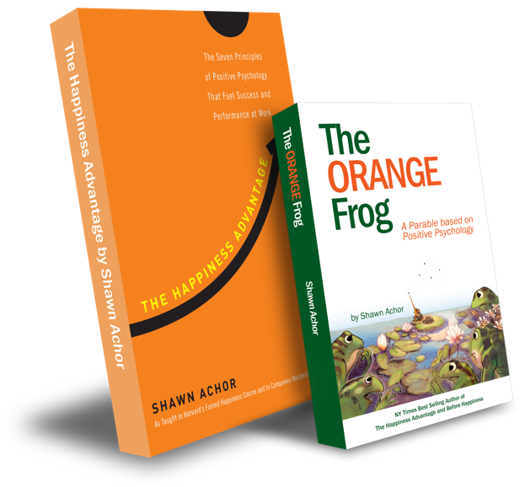
The Orange Frog
Gratitudes
Week 1
Intro to Gratitude
By Shawn Achor
Notes:
(Send this link out in advance.) Watch this video from Good Morning America https://youtu.be/01psTtw2wZc

Slide 3
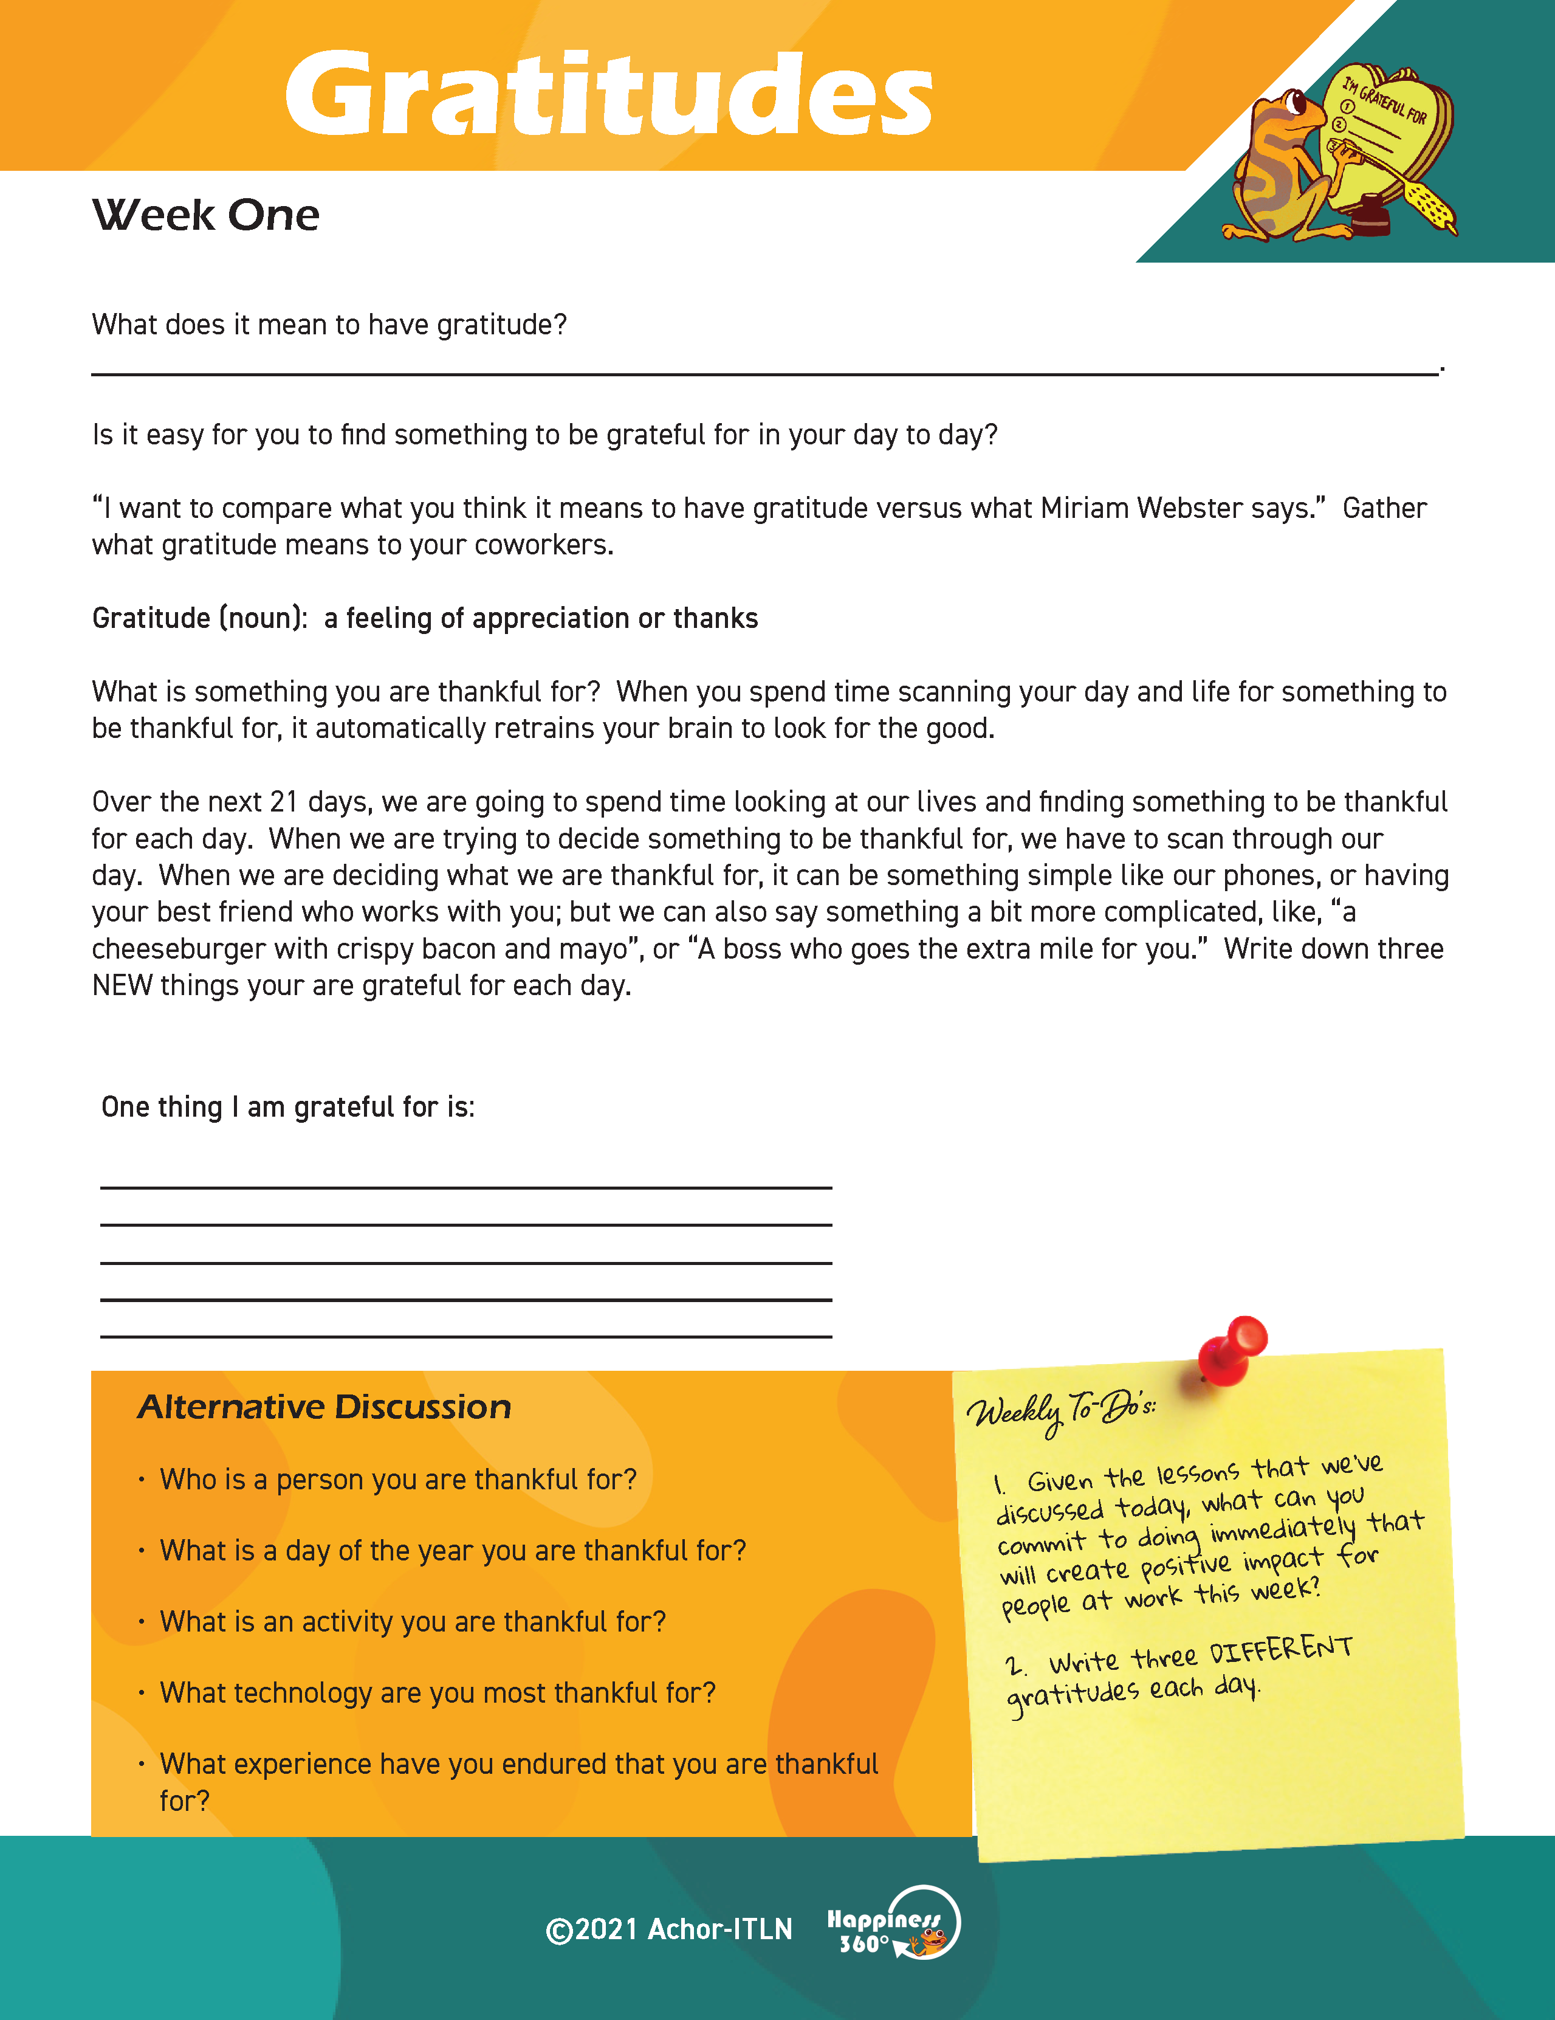
Each week, you’ll find a Worksheet in the resources section of the website and your Gratitude Journal.
Please, have those available.
\

Slide 4
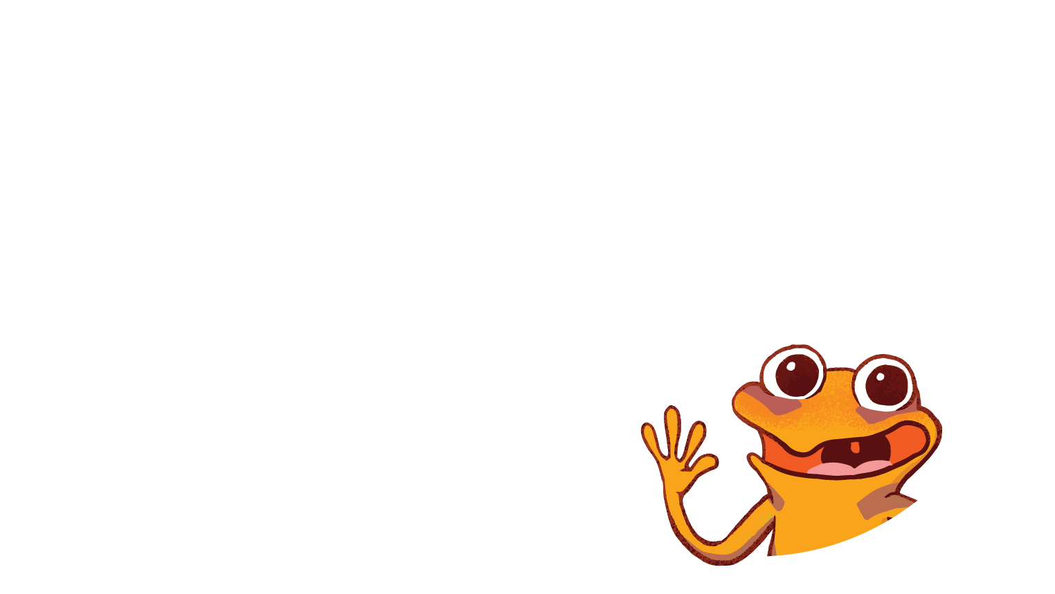
Did you get a chance to watch the Good Morning America video featuring Shawn and Gratitudes?
Prework
Expectations
Notes:
(Send this link out in advance.) Watch this video from Good Morning America https://youtu.be/01psTtw2wZc

Slide 5
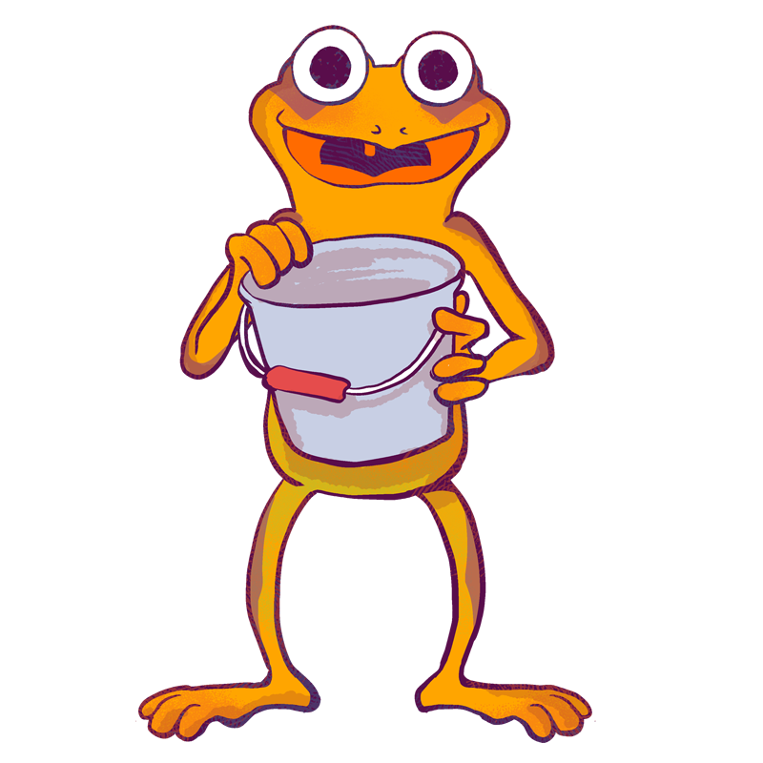
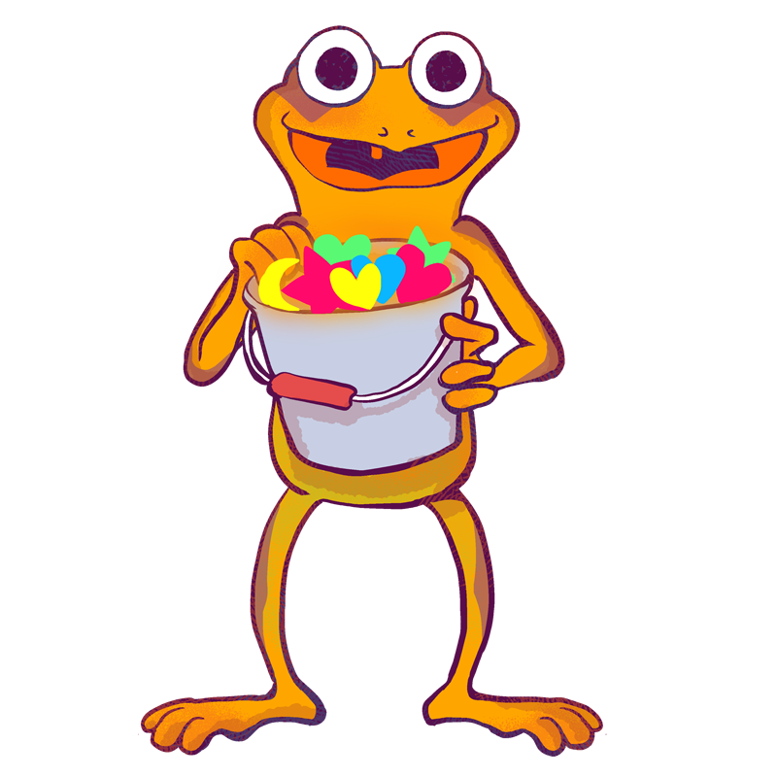
Gratitudes
Learning Objective: (“Each participant…”)
Can define gratitude
Will discuss the importance of being thankful for the things in their life
Notes:
Essential Concept:
Essential Concept and/or Skill: Communicate and work productively with others emphasizing collaboration and cultural awareness to produce quality work.
Interact positively as a team member.
Cooperate with others in a group setting.
Generate ideas with group members.
Are active listeners.
Read and understand information in a variety of forms.
Express ideas.
Skill:
Active listening, express ideas

Slide 6
Essential Concept
Demonstrate leadership, integrity, ethical behavior, and social responsibility in all environments.

Slide 7
Skills
Communicate clearly
Collaborate on structured tasks
Show sensitivity to others’ views and ideas
Understand how to create consensus
Use active listening and speaking skills
Positively support the work of others

Slide 8
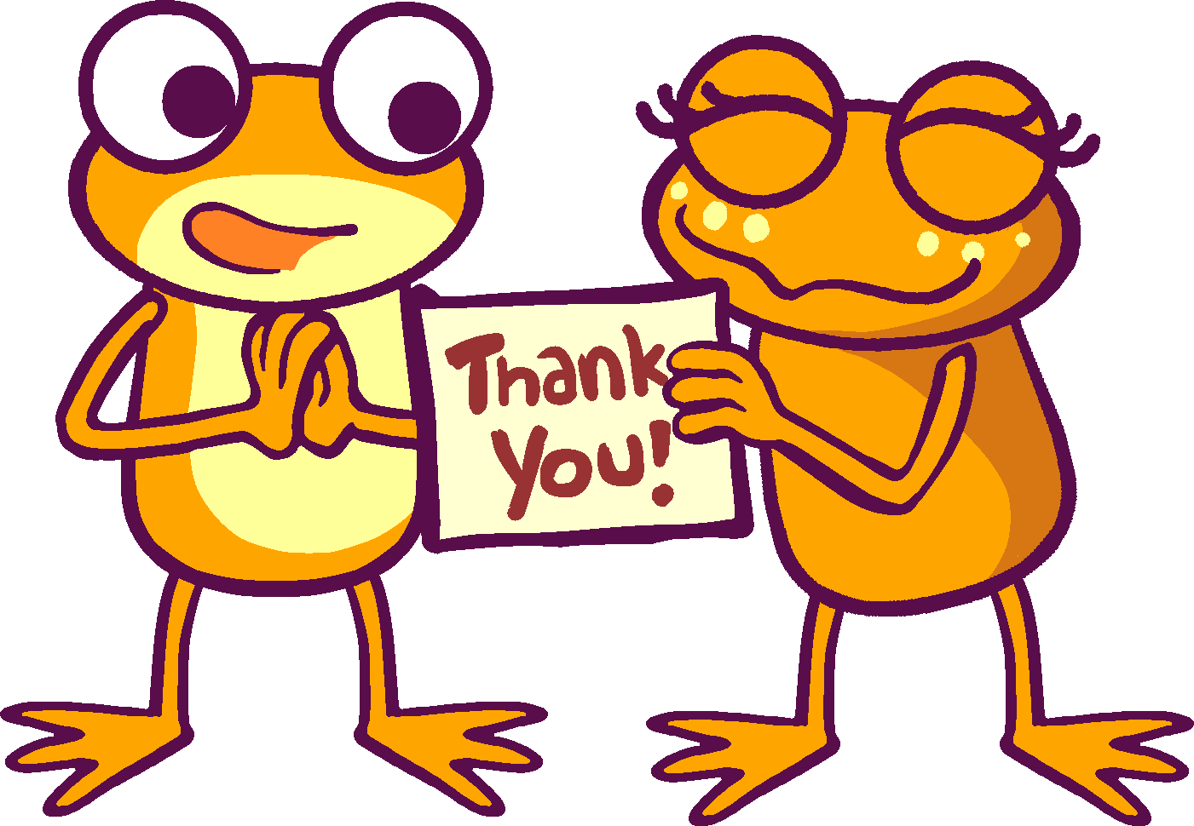
What does it mean to have gratitude?
And
Is it easy for you to find something to be grateful for in your day?

Slide 9
Hack Your Happiness

Slide 10
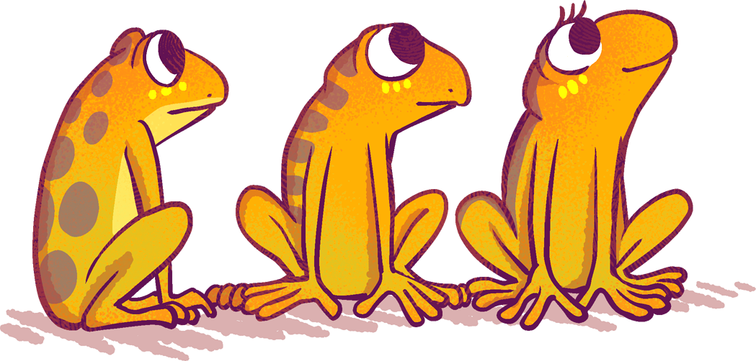
What Is Gratitude?
Let’s chat about our understanding of gratitude from our personal perspectives.
Notes:
Take comments from participants. Develop a working understanding of the word. Write notes, thoughts, comments on the screen or whiteboard. Then ask participants to define the word using the MW dictionary online.
If you’re present together in a room, you can ask them to turn and talk to their elbow partner about the definition.
Participants will need to compare what they know versus what they know now. How is it different? How is it the same?
To have gratitude means that you show you are thankful for something.
What is something you are thankful for? When you spend time scanning your day and life for
something to be thankful for, it automatically retrains your brain to look for the good.”

Slide 11
More Thoughts on Gratitude…
How is your definition different from what you might find in a dictionary. (Feel free to look it up.)
To have gratitude means that you show you are thankful for something.
What is something you are thankful for?
When you spend time scanning your day and life for something to be thankful for, it automatically retrains your brain to look for the good.

Slide 12
Connecting this Lesson to Our Work
How can showing gratitude at work impact my work and the work of others?
Who benefits from a culture that expresses gratitude?

Slide 13
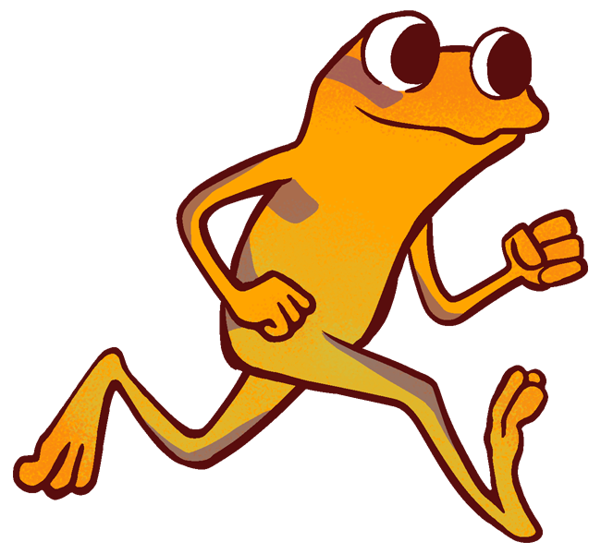
Activity
Over the next 21 days, we are going to spend time looking at our lives and finding something to be thankful for each day.
When we are trying to decide something to be thankful for, we have to scan through our day.

Slide 14
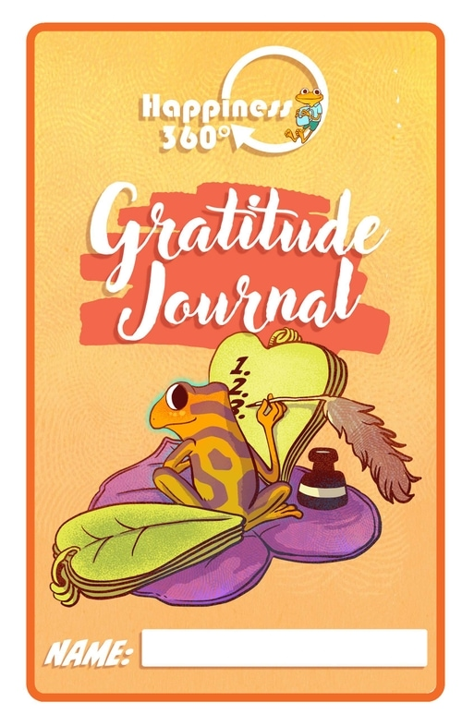
21-day Gratitude Journal
When we are deciding what we are thankful for, it can be something simple like:
“A great cup of coffee!” or “I’m thankful for my dog.”
Using complete sentences will help you provide the detail required to make this tactic genuinely impactful.

Slide 15
21-day Gratitude Journal
But we can also write down something a bit more complicated:
“I’m grateful for my colleagues who’ve always got my back when things get challenging.”
Or
“A supervisor/leader who went the extra mile for me.”

Slide 16
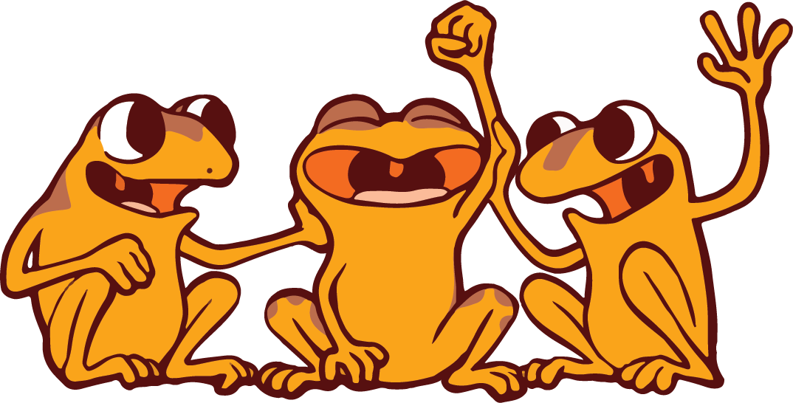
BONUS
Who is a person you’re thankful for?
What is a day of the year you’re thankful for?
What is an activity you’re thankful for?
What is an app on technology you’re most thankful for?
What experience have you endured that you are most thankful for?

Slide 17
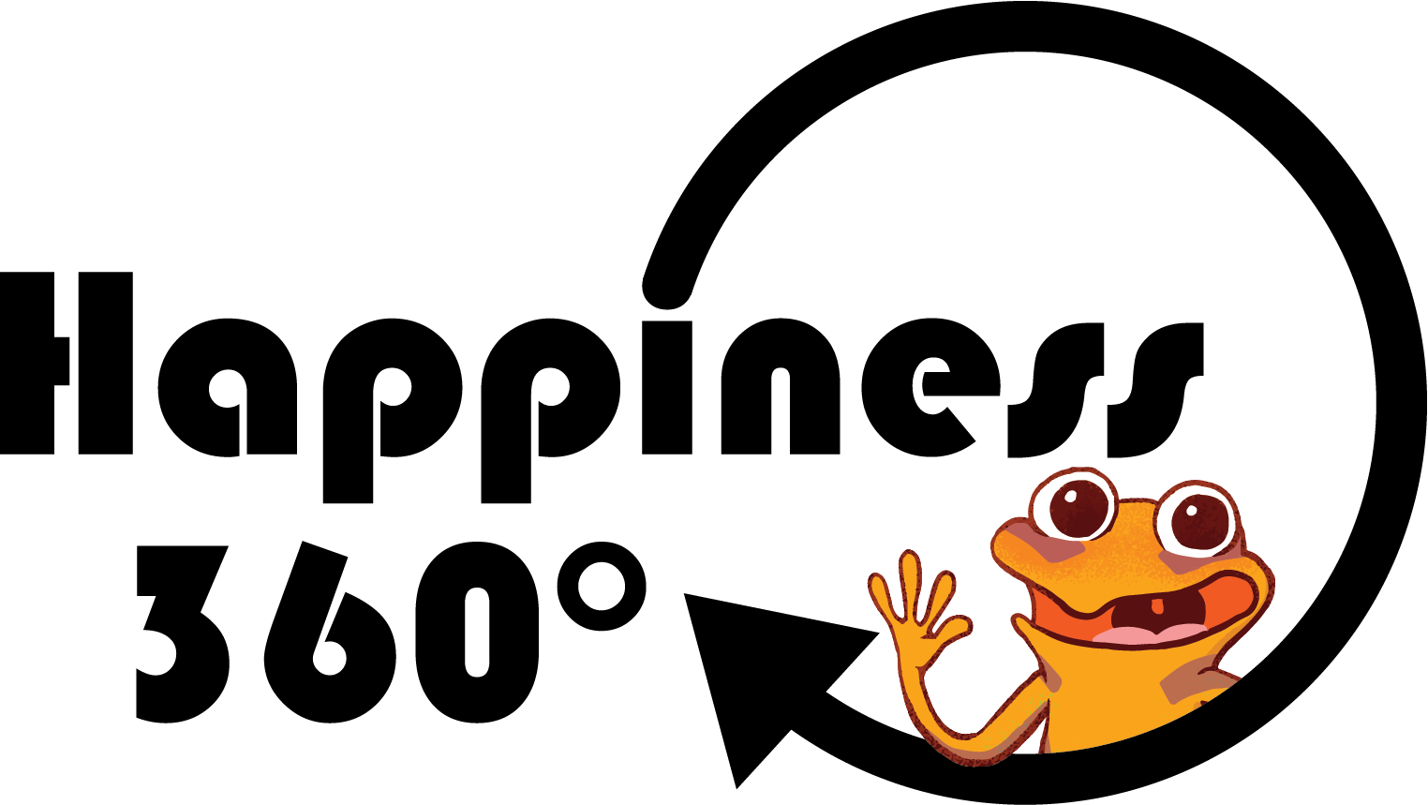
Weekly To-Dos
Get started on your 21-day Gratitude challenge and keep it going.
Make sure to use the Gratitude Journal to track your progress.

